Slide 1

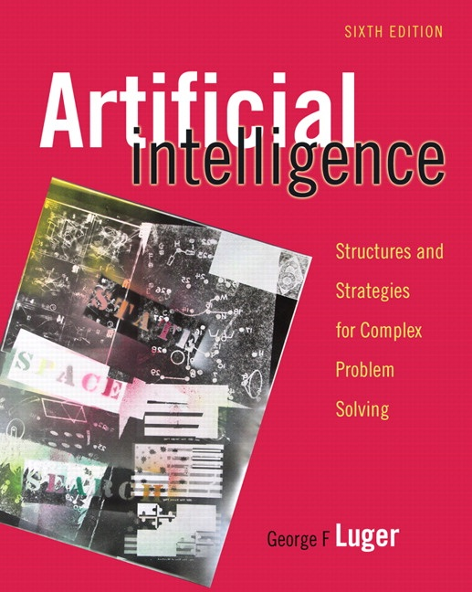
Machine Learning: Connectionist
11.0 Introduction
11.1 Foundations for Connectionist
Networks
11.2 Perceptron Learning
11.3 Backpropagation Learning.
11.4 Competitive Learning
11.5 Hebbian Coincidence Learning
11.6 Attractor Networks or “Memories”
11.7 Epilogue and References
11.8 Exercises
George F Luger
ARTIFICIAL INTELLIGENCE 6th edition
Structures and Strategies for Complex Problem Solving
Luger: Artificial Intelligence, 6th edition. © Pearson Education Limited, 2009
1

Slide 2
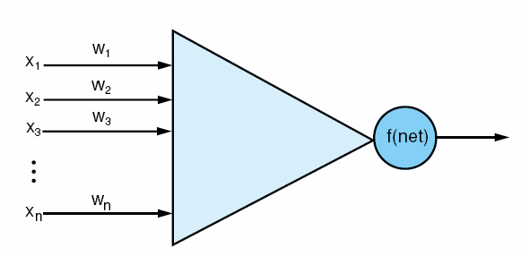
Fig 11.1 An artificial neuron, input vector x_{i}, weights on each input line, and a thresholding function f that determines the neuron’s output value. Compare with the actual neuron in fig 1.2
Luger: Artificial Intelligence, 6th edition. © Pearson Education Limited, 2009
2

Slide 3
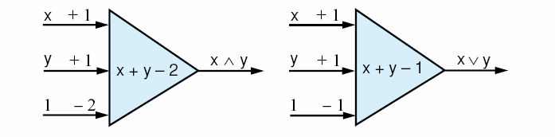
Fig 11.2 McCulloch-Pitts neurons to calculate the logic functions and and or.
Luger: Artificial Intelligence, 6th edition. © Pearson Education Limited, 2009
3

Slide 4
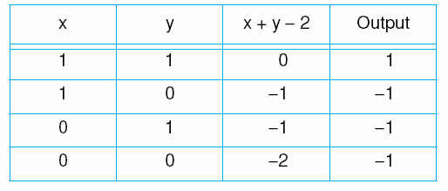
Table 11.1 The McCulloch-Pitts model for logical and.
Luger: Artificial Intelligence, 6th edition. © Pearson Education Limited, 2009
4

Slide 5
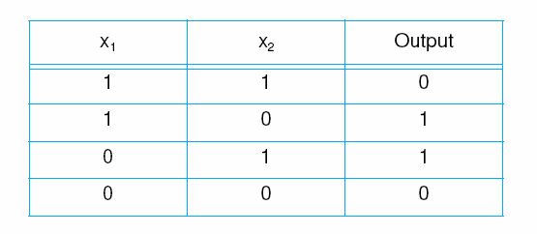
Table 11.2 The truth table for exclusive-or.
Luger: Artificial Intelligence, 6th edition. © Pearson Education Limited, 2009
5

Slide 6
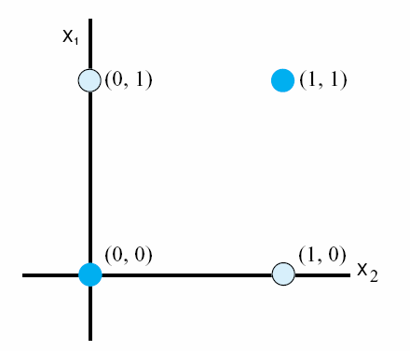
Fig 11.3 The exclusive-or problem. No straight line in two-dimensions can separate the (0, 1) and (1, 0) data points from (0, 0) and (1, 1).
Luger: Artificial Intelligence, 6th edition. © Pearson Education Limited, 2009
6

Slide 7
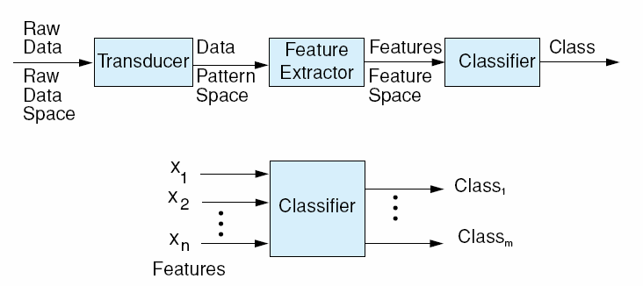
Fig 11.4 A full classification system.
Luger: Artificial Intelligence, 6th edition. © Pearson Education Limited, 2009
7

Slide 8
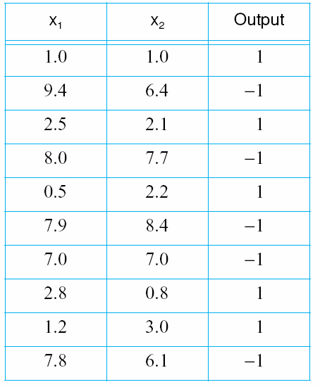
Table 11.3 A data set for perceptron classification.
Luger: Artificial Intelligence, 6th edition. © Pearson Education Limited, 2009
8

Slide 9
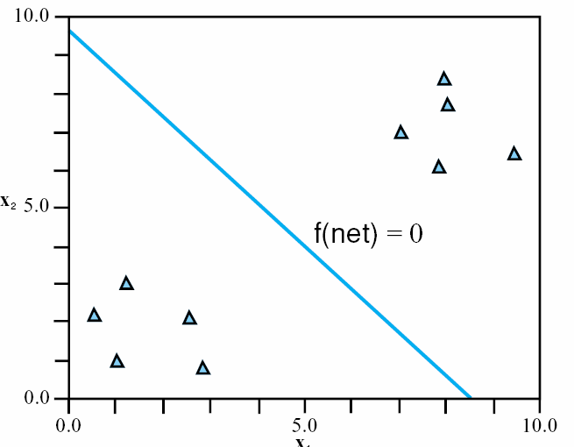
Fig 11.5 A two-dimensional plot of the data oints in Table 11.3. The perceptron of Section 11.2.1 provides a linear separation of the data sets.
Luger: Artificial Intelligence, 6th edition. © Pearson Education Limited, 2009
9

Slide 10
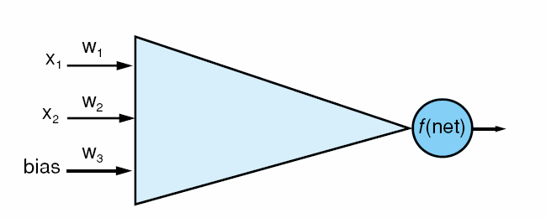
Fig 11.6 The perceptron net for the example data of Table 11.3. The thresholding function is linear and bipolar (see fig 11.7a)
ΣX_{i}W_{i}
Luger: Artificial Intelligence, 6th edition. © Pearson Education Limited, 2009
10

Slide 11
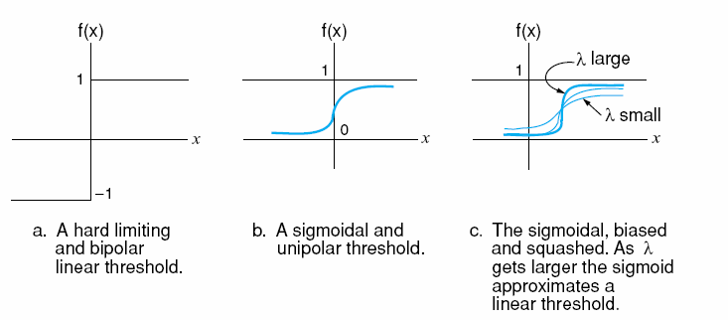
Fig 11.7 Thresholding functions.
Luger: Artificial Intelligence, 6th edition. © Pearson Education Limited, 2009
11

Slide 12
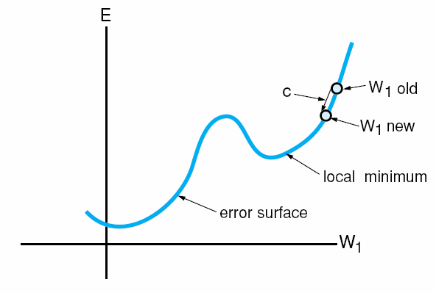
Fig 11.8 An error surface in two dimensions. Constant c dictates the size of the learning step.
Luger: Artificial Intelligence, 6th edition. © Pearson Education Limited, 2009
12

Slide 13
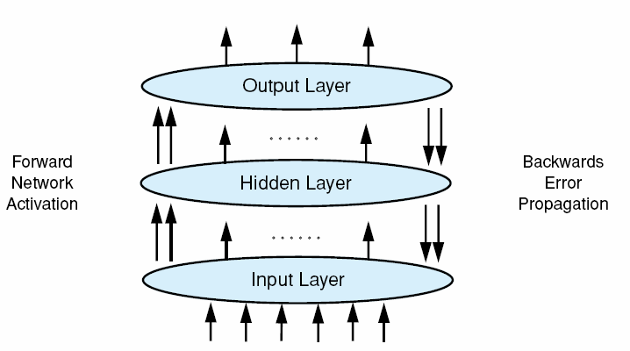
Fig 11.9 Backpropagation in a connectionist network having a hidden layer.
Luger: Artificial Intelligence, 6th edition. © Pearson Education Limited, 2009
13

Slide 14
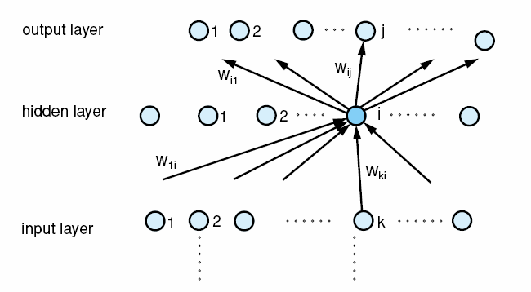

Fig 11.10
Luger: Artificial Intelligence, 6th edition. © Pearson Education Limited, 2009
14

Slide 15
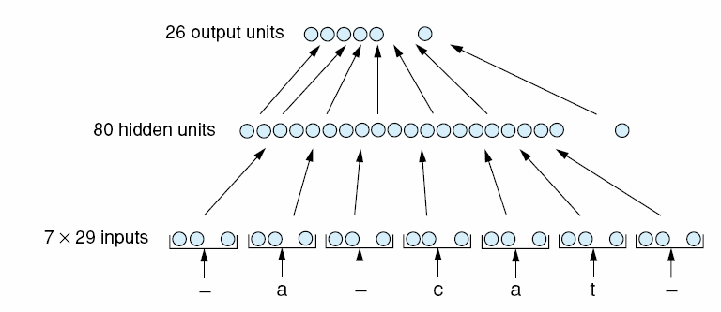
Fig 11.11 The network topology of NETtalk.
Luger: Artificial Intelligence, 6th edition. © Pearson Education Limited, 2009
15

Slide 16
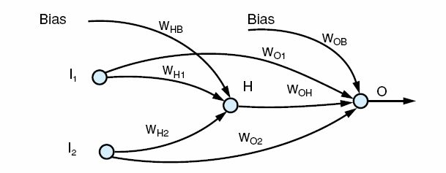
Fig 11.12 A backpropagation net to solve the exclusive-or problem. The W_{ij} are the weights and H is the hidden node.
Luger: Artificial Intelligence, 6th edition. © Pearson Education Limited, 2009
16

Slide 17
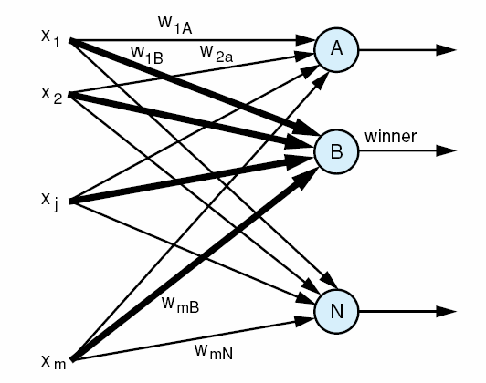
Fig 11.13 A layer of nodes for application of a winner-take-all algorithm. The old input vectors support the winning node.
Luger: Artificial Intelligence, 6th edition. © Pearson Education Limited, 2009
17

Slide 18
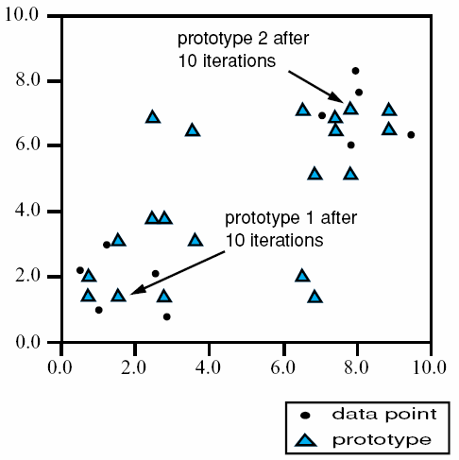
Fig 11.14 The use of a Kohonen layer, unsupervised, to generate a sequence of prototypes to represent the classes of Table 11.3.
Luger: Artificial Intelligence, 6th edition. © Pearson Education Limited, 2009
18

Slide 19
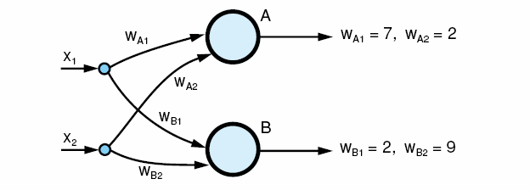
Fig 11.15 The architecture of the Kohonen based learning network for the data of Table 11.3 and classification of Fig 11.4.
Luger: Artificial Intelligence, 6th edition. © Pearson Education Limited, 2009
19

Slide 20
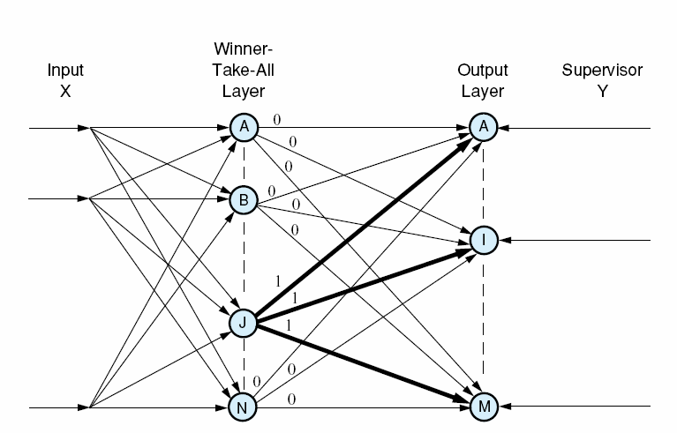
Fig 11.16 The “outstar” of node J, the “winner” in a winner-take-all network. The Y vector supervises the response on the output layer in Grossberg training. The “outstar” is bold with all weights, 1; all other weights are 0.
Luger: Artificial Intelligence, 6th edition. © Pearson Education Limited, 2009
20

Slide 21
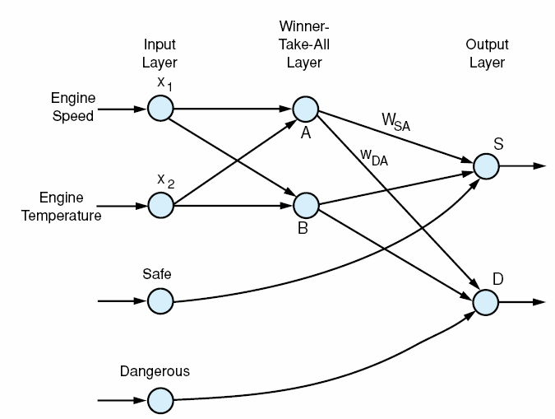
Fig 11.17 A counterpropagation network to recognize the classes in Table 11.3. We train the outstar weights of node A, w_{sa} and w_{da} .
Luger: Artificial Intelligence, 6th edition. © Pearson Education Limited, 2009
21

Slide 22
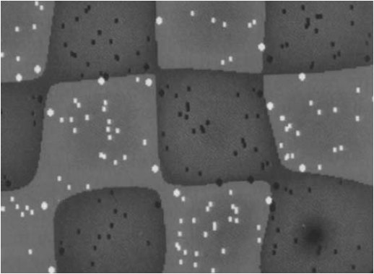
Fig 11.18 A SVM learning the boundaries of a chess board from points generated according to the uniform distribution using Gaussian kernels. The dots are the data points with the larger dots comprising the set of support vectors, the darker areas indicate the confidence in the classification. Adapted from Cristianini and Shawe-Taylor (2000).
Luger: Artificial Intelligence, 6th edition. © Pearson Education Limited, 2009
22

Slide 23
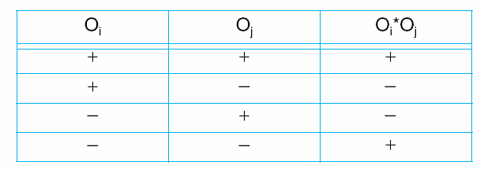
Table 11.4 The signs and product of signs of node output values.
Luger: Artificial Intelligence, 6th edition. © Pearson Education Limited, 2009
23

Slide 24
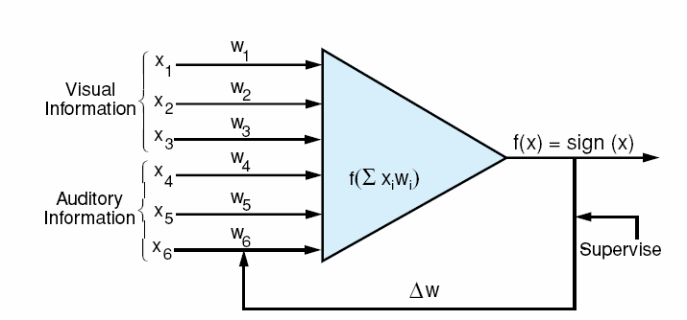
Fig 11.19 An example neuron for application of a hybrid Hebbian node where learning is supervised.
Luger: Artificial Intelligence, 6th edition. © Pearson Education Limited, 2009
24

Slide 25
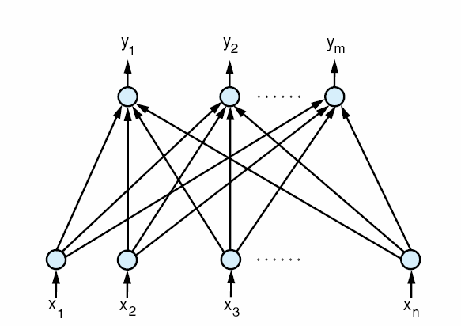
Fig 11.20 A supervised Hebbian network for learning pattern association.
Luger: Artificial Intelligence, 6th edition. © Pearson Education Limited, 2009
25

Slide 26
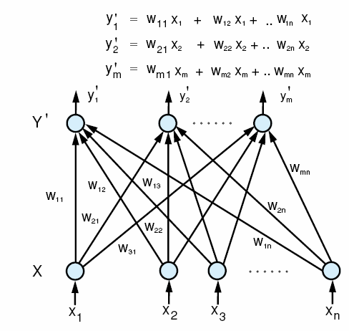
Fig 11.21 The linear association network. The vector X_{i} is entered as input and the associated vector Y is produced as output. y_{i} is a linear combination of the x input. In training each y_{i} is supplied with its correct output signals.
Luger: Artificial Intelligence, 6th edition. © Pearson Education Limited, 2009
26

Slide 27
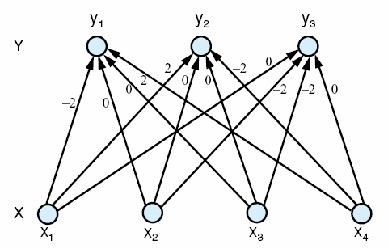
Fig 11.22 A linear associator network for the example in Section 11.5.4. The weight matrix is calculated using the formula presented in the previous section.
Luger: Artificial Intelligence, 6th edition. © Pearson Education Limited, 2009
27

Slide 28
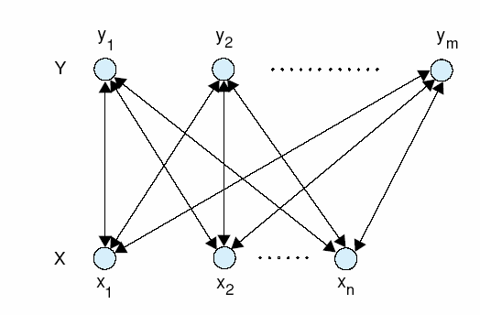
Fig 11.23 A BAM network for the examples of Section 11.6.2. Each node may also be connected to itself.
Luger: Artificial Intelligence, 6th edition. © Pearson Education Limited, 2009
28

Slide 29
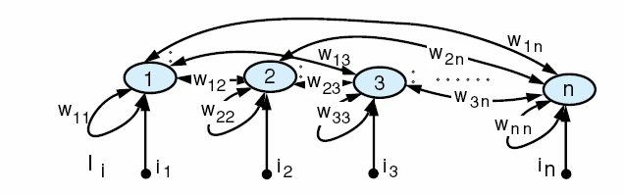
Fig 11.24 An autoassociative network with an input vector I_{i}. We assume single links between nodes with unique indices, thus w_{ij} = w_{ij} and the weight matrix is symmetric.
Luger: Artificial Intelligence, 6th edition. © Pearson Education Limited, 2009
29

